Slide 1
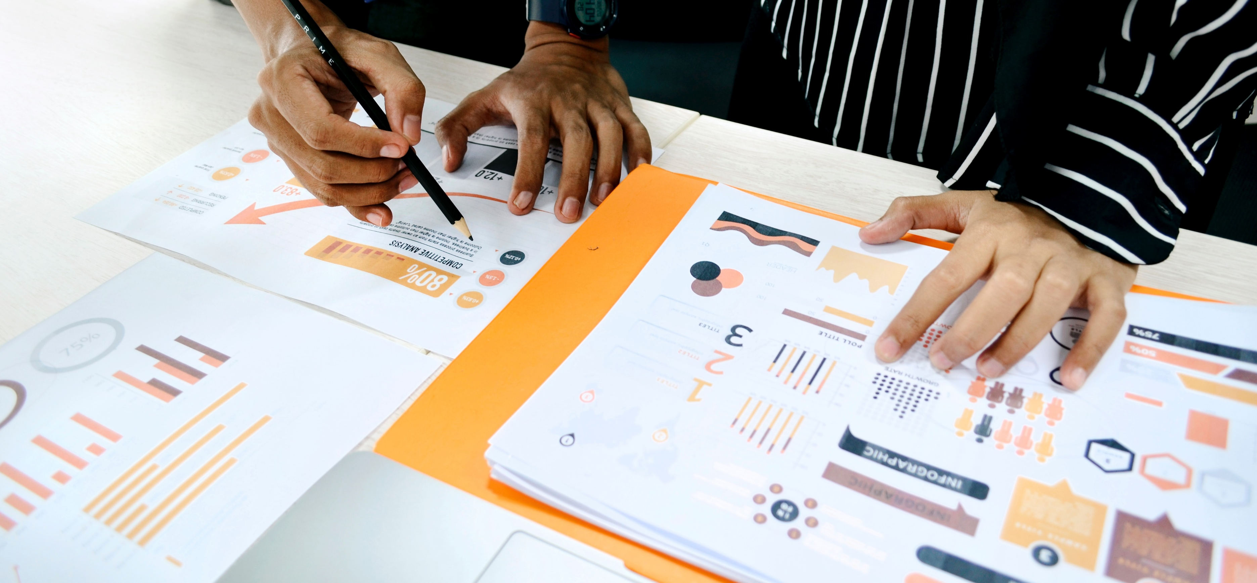
Project Presentation
Front-End Developer for Data Visualisation
Lukas Haack 15. Nov. 2023

Slide 2
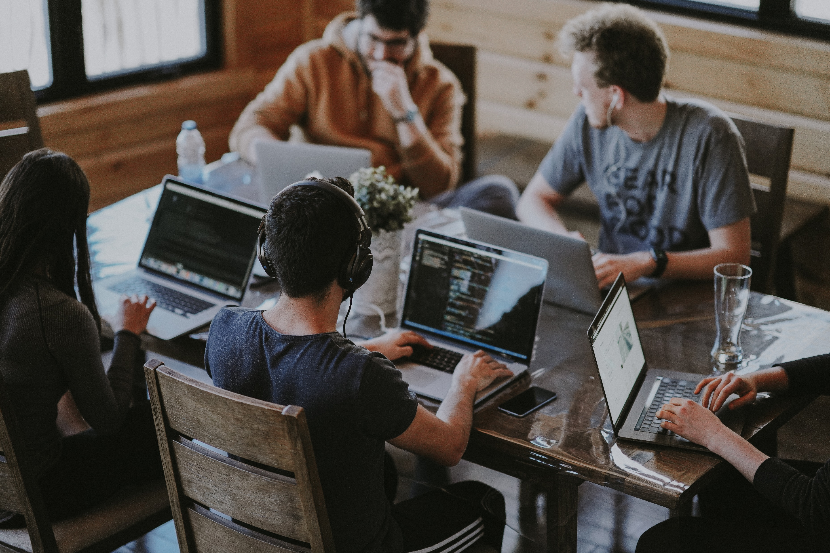
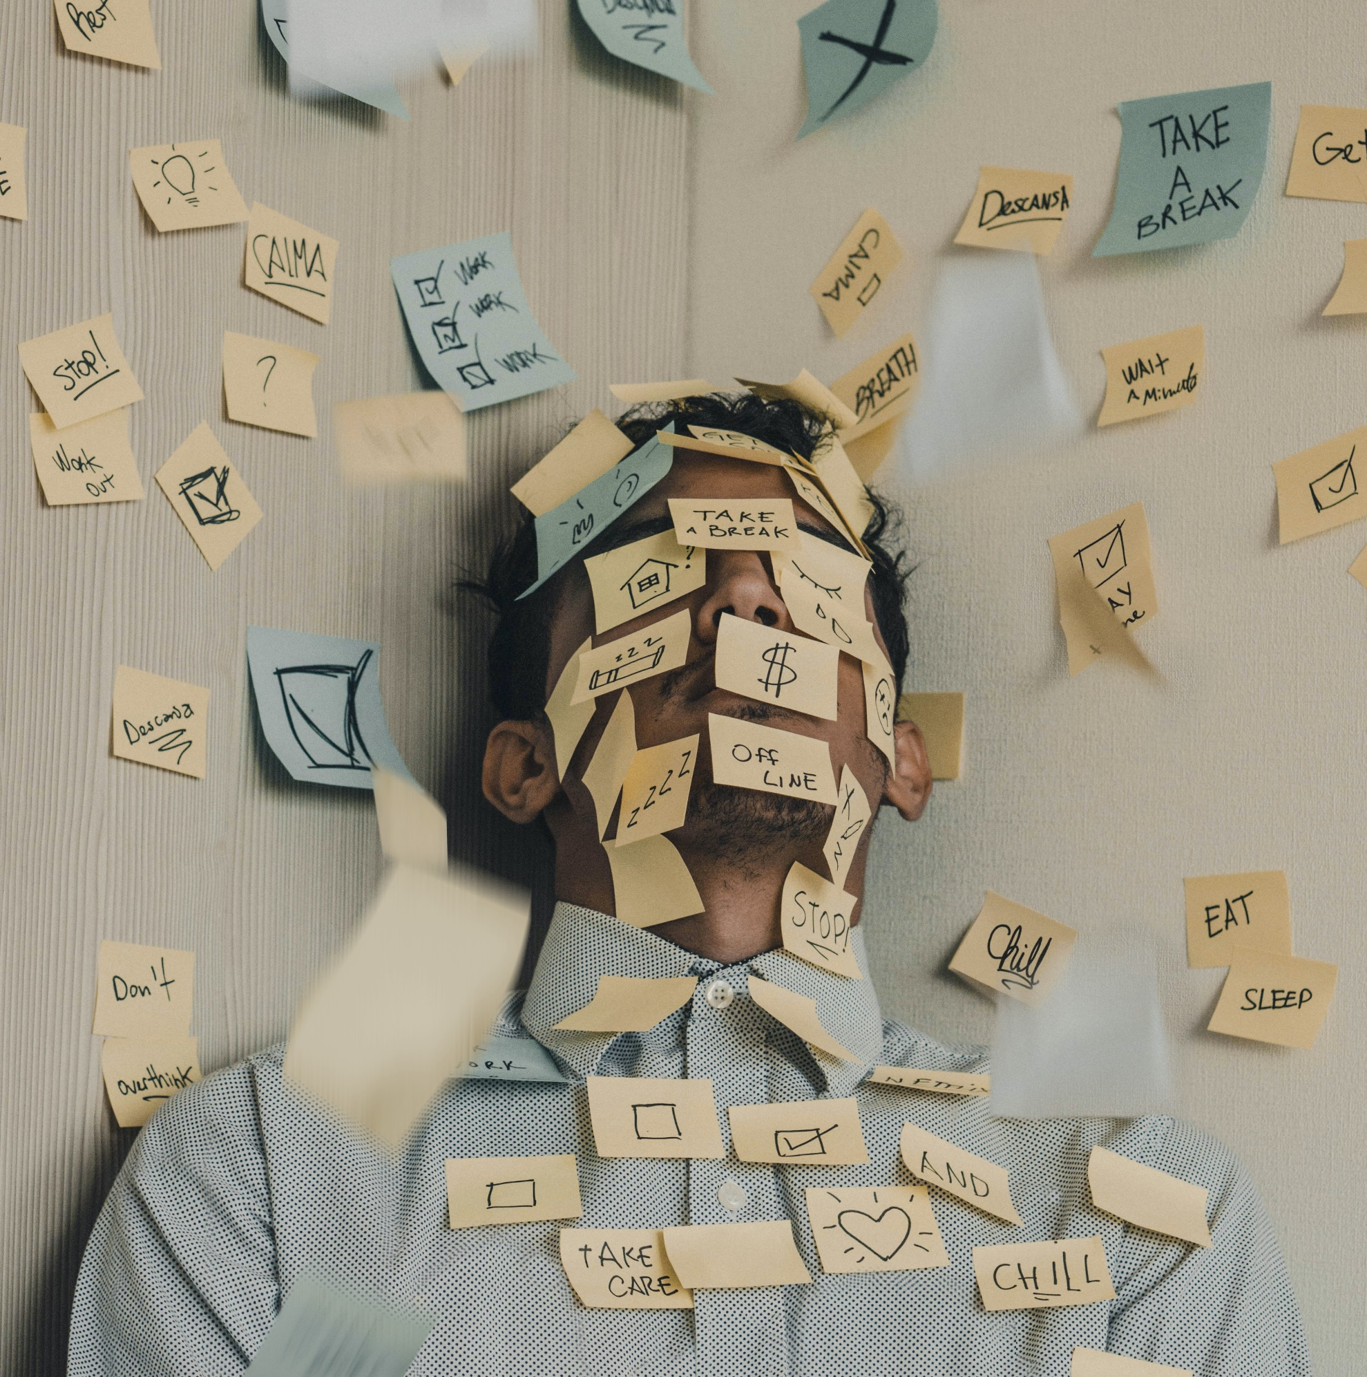


Audience & Objective
Students
How is everyday life structured? Are there well-established rou-tines? How to induce positive change?
Behavioural Patterns
We want to under-stand correlations between our behaviour and wellbeing.
Explorative Analysis
We want to explore the data in search of hypotheses about the relationship between individual attributes.
Affirmative Analysis
We want to be able to use the application to verify or refute our existing hypotheses.

Slide 3
Project Concept – Shneiderman‘s 7 Rules for Interaction Design
Overview
Zoom
Filter
Details on Demand
Relate
History
Extract
Multibrushing
Colorisation
Details on Demand
Brush Modes

Slide 4
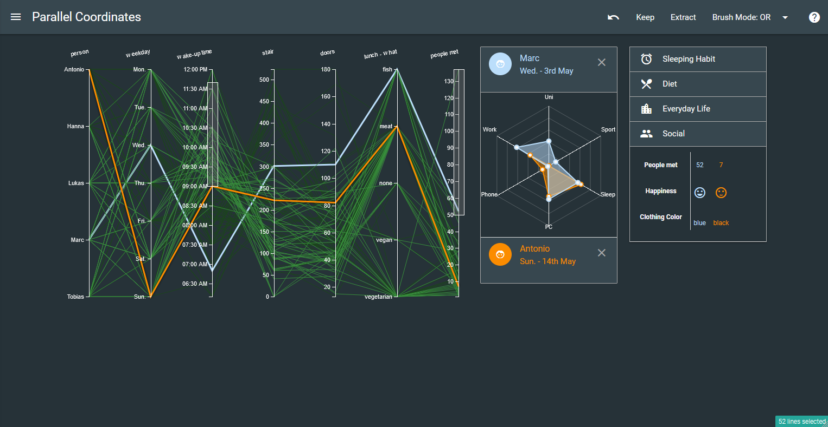
Tech Stack & Web Demo
Web-based application using
HTML
JS
CSS
Development supported by frameworks:
D3.js
jQuery
materialize.css
Codebase & Demo available online

